Slide 1
Automated Quality Control of Observed Weather Station Data
Dr. Ranjini Swaminathan and Dr. Katharine Hayhoe
Texas Tech University
U.S.-India Partnership for Climate Resilience
Workshop on Development and Applications of Downscaling Climate Projections
Notes:
KH: On the title slide we usually put our affiliation not the other people’s. I fixed it.

Slide 2
The Challenge of Station Data
Weather station records are often the best long-term data we have – but they do not represent absolute truth.
Errors and uncertainty can be introduced by:
Lack of standardization - measurements made at different times of day, in different locations, and/or with different equipment
Instrumentation error – instruments may not be calibrated, or may drift over time, or be affected by a natural or human event
Human error – recording, selection, and/or reading errors

Slide 3
Types of Errors*
Random Errors are distributed more or less symmetrically around zero and do not depend on the measured value. Random errors sometimes result in overestimation and sometimes in underestimation of the actual value. On average, the errors cancel each other out.
Systematic Errors are distributed asymmetrically around zero. On average these errors tend to bias the measured value either above or below the actual value. One reason of random errors is a long-term drift of sensors.
*World Meteorological Organization Quality Control Guidelines, 2004

Slide 4
Types of Errors*
Large (rough) Errors are caused by malfunctioning of measurement devices or by mistakes made during data processing; errors are easily detected by checks.
Micrometeorological (representativeness) Errors are the result of small-scale perturbations or weather systems affecting a weather observation. These systems are not completely observable by the observing system due to the temporal or spatial resolution of the observing system. When such a phenomenon occurs during a routine observation, the results may look strange compared to surrounding observations taking place at the same time.
*World Meteorological Organization Quality Control Guidelines, 2004

Slide 5
The Challenge of Station Data
These and other types of errors and uncertainties can lead to:
Missing data
Unit errors
Faulty data points
Records that have been swapped or exchanged
Other types of biased and/or incorrect records
Notes:
KH: anything else we are missing here?

Slide 6
What station data are we working with?
Variables – Daily Temperature (daily maximum, minimum, average) and 24 Hour Cumulative Precipitation
Sources - Global Historical Climatology Network (GHCN), Met Office Integrated Data Archive System (MIDAS), BASINS (Better Assessment Science Integrating point & Non-point Sources), Europe Climate Assessment and Dataset, NOAA and more
Notes:
KH: what about Indian data sources? Can we cite any of them here? Would be good to have at least one listed under sources

Slide 7
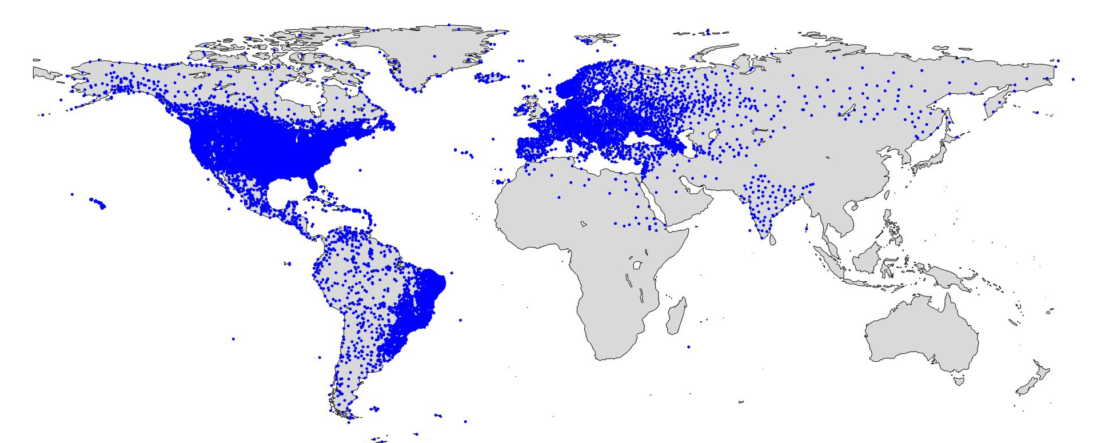
Geographic distribution of stations
Notes:
KH: This figure is going to be a bit problematic because we simply haven’t downloaded the Australian data. If anyone asks, be sure to say that!

Slide 8
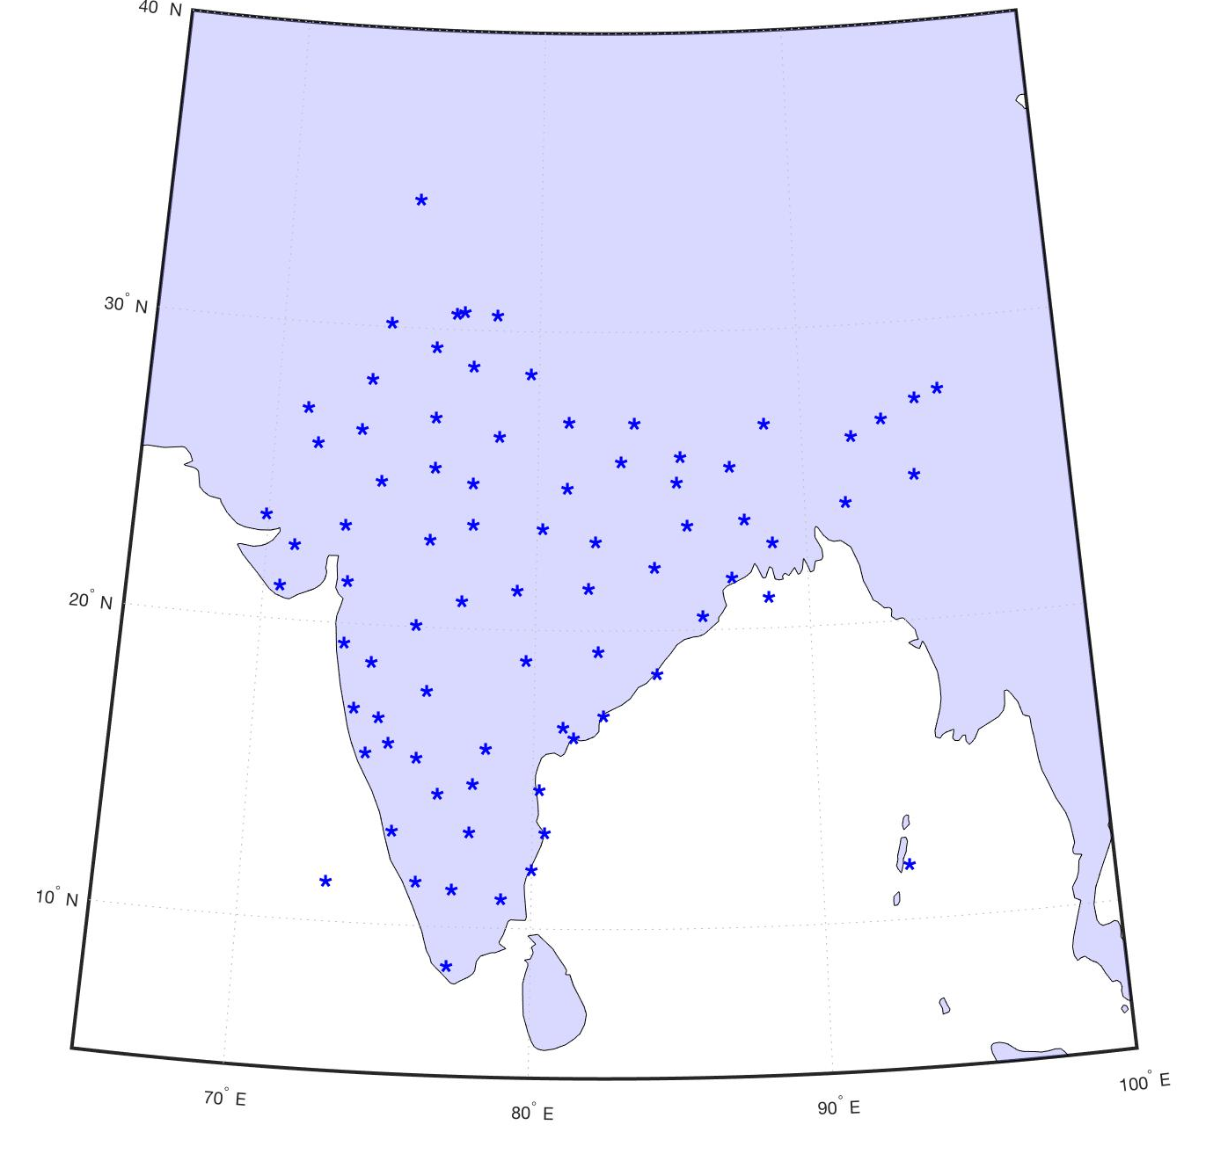
Long-term weather stations in India
79 weather stations
64 with sufficient long-term data to be used for downscaling
Maximum and minimum temperature, 24 hour cumulative precipitation

Slide 9
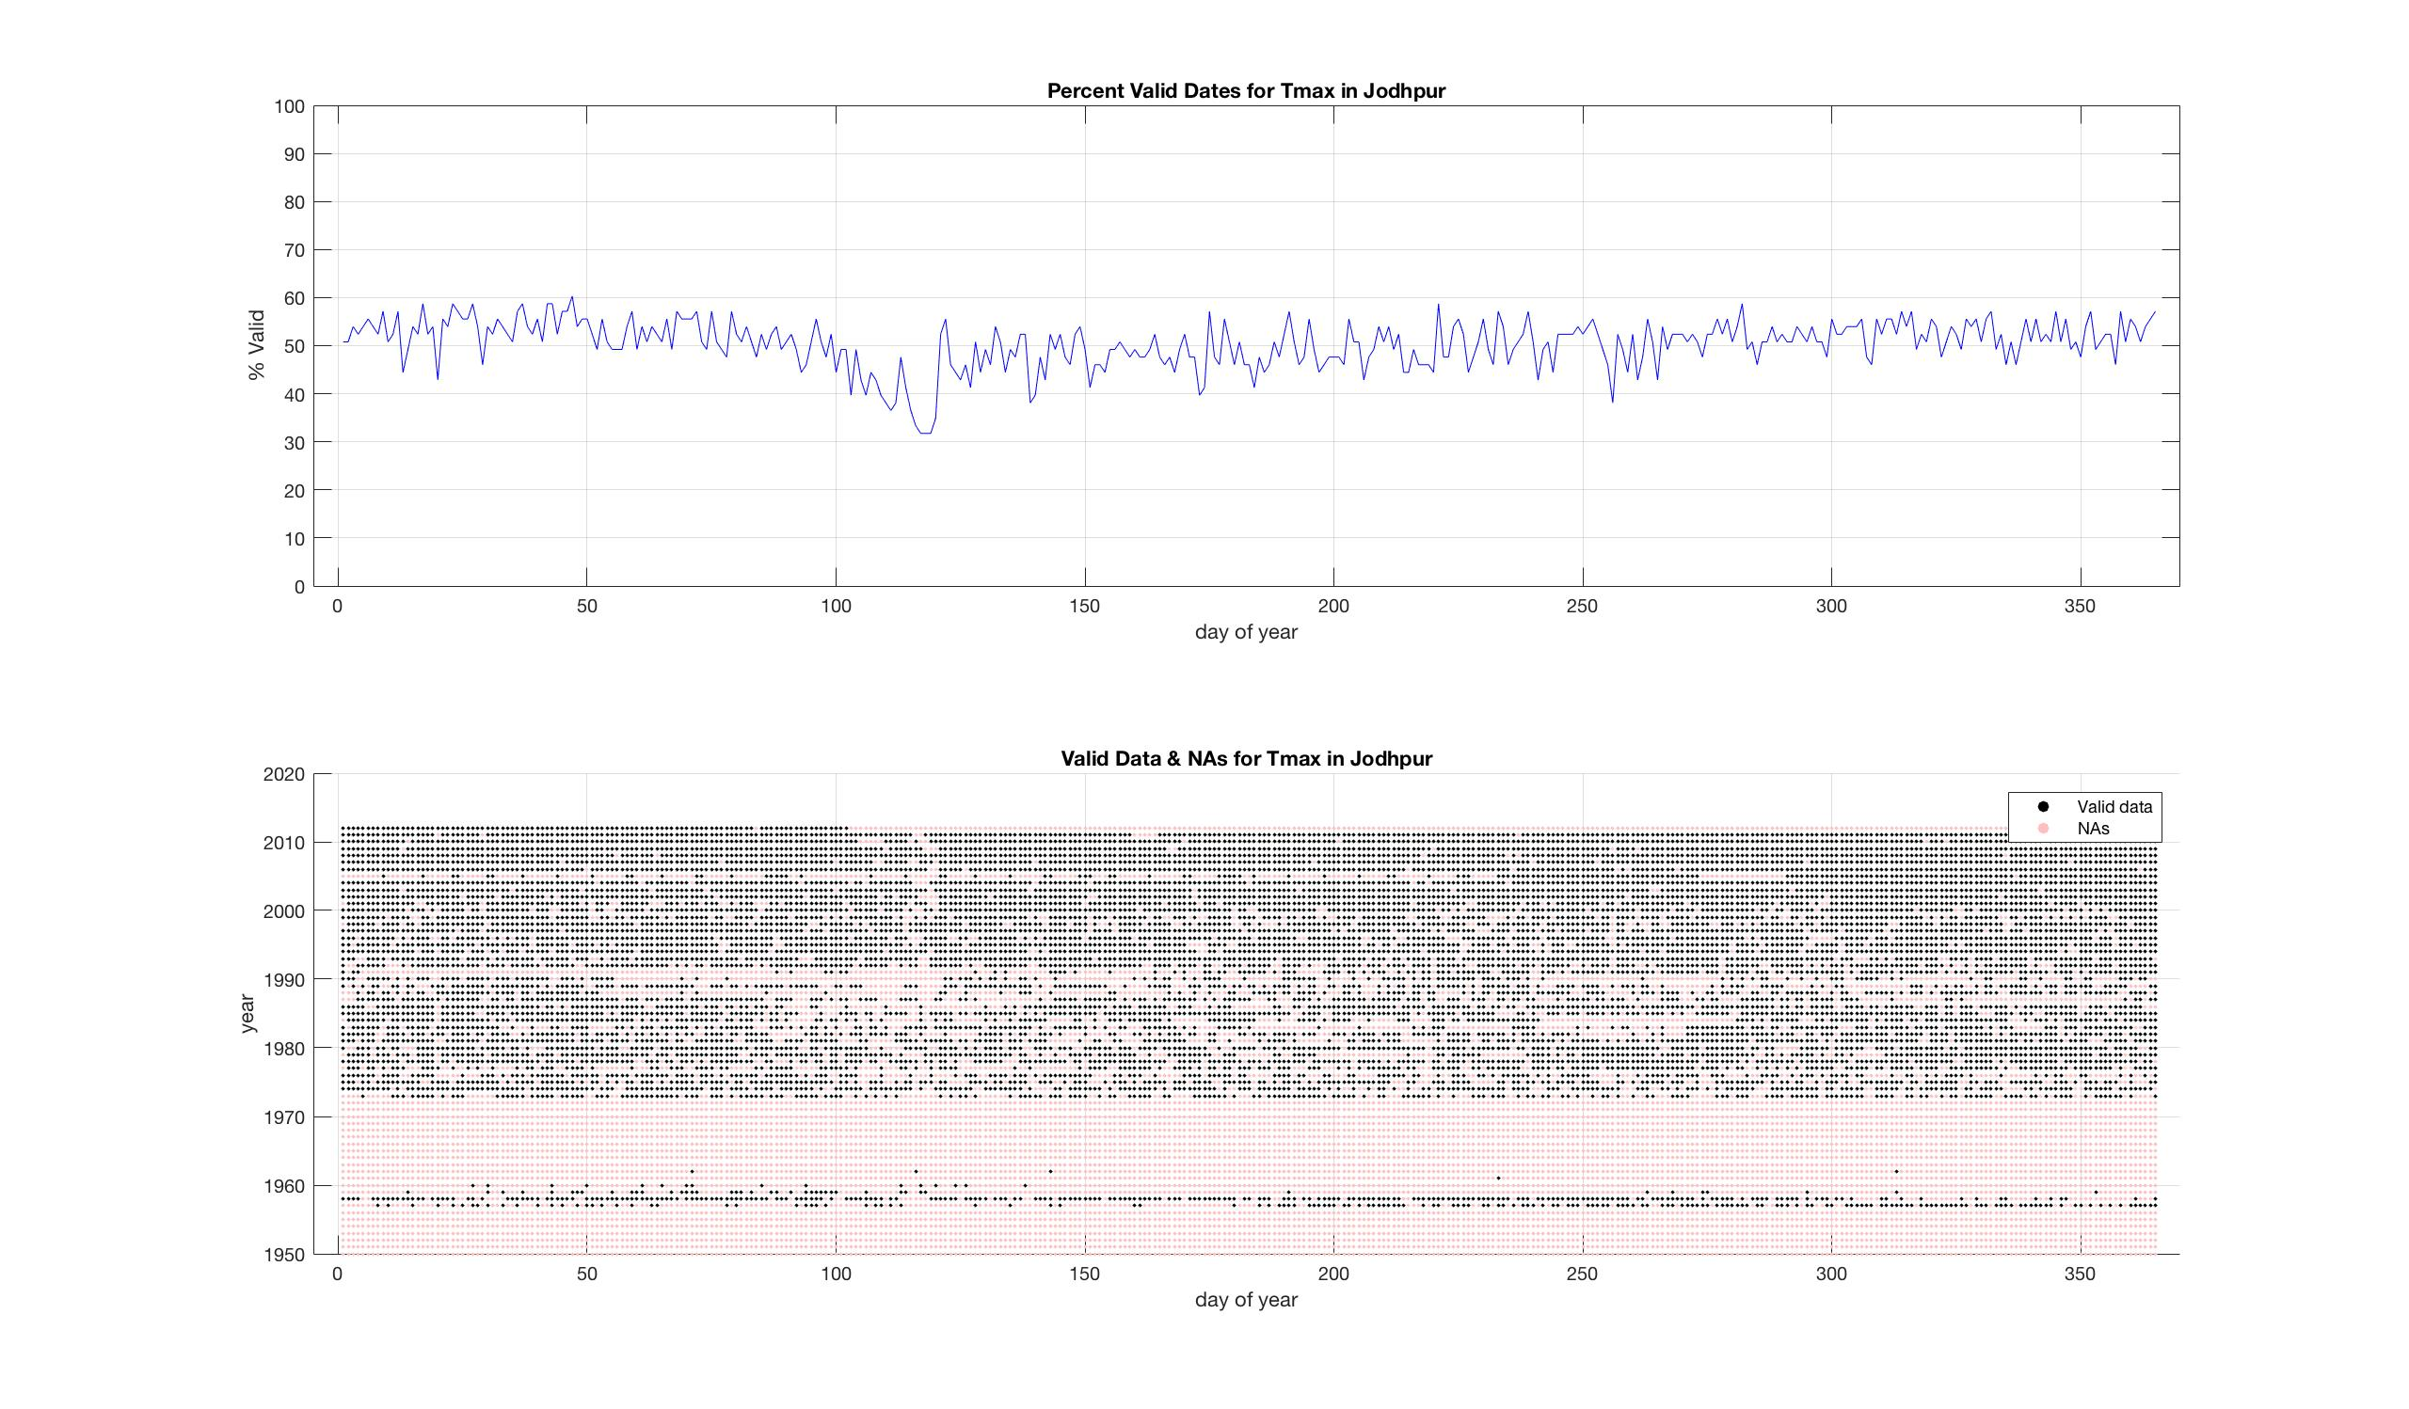
Data Availability – Example: Jodhpur
Percent Valid Dates per Day of Year
Percentage
Day of Year
Valid Dates by Year
Year
Day of Year
Notes:
You can tell people the images were generated with Ian’s code, but don’t put it on the slide. TMI!
In the future, make sure the figure labels are REALLY BIG so people can read them. Don’t worry about it now, but in the future.

Slide 10
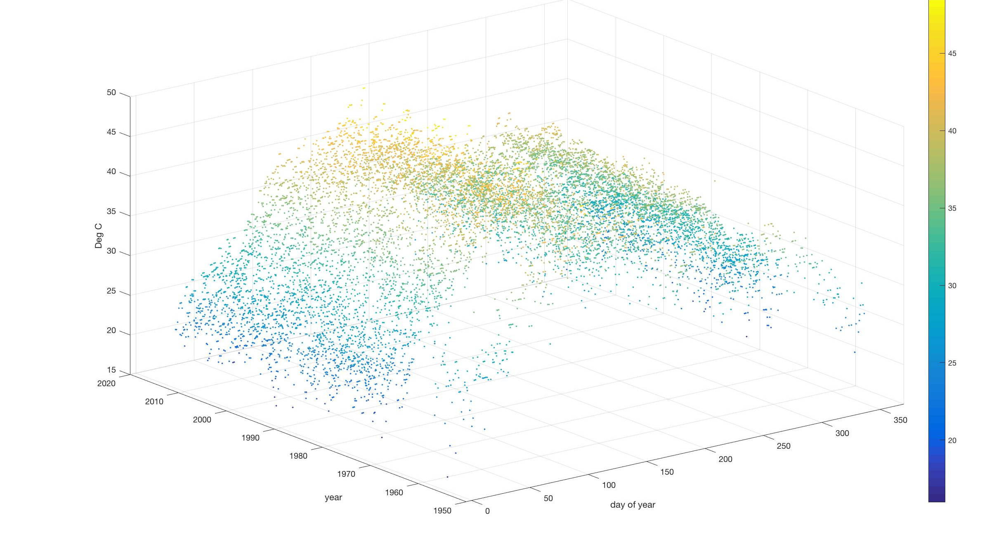
Data Availability – Example: Jodhpur
TEMPERATURE
TEMPERATURE (degC)
YEAR
DAY OF YEAR

Slide 11
QA and QC: WMO Definitions
Quality Control – The operational techniques and activities that are used to fulfil requirements for quality.
Quality Assurance -- All the planned and systematic activities implemented within the quality system, and demonstrated as needed, to provide adequate confidence that an entity will fulfil requirements for quality.
*World Meteorological Organization Quality Control Guidelines, 2004

Slide 12
Our QC Method: Basic Checks
Plausible Value Checks :
      Temperature and Precipitation – check against maximum and minimum values recorded for country/state/continent.
      Temperature -- Tmax > Tmin
Systemic Error Checks: Repeated values (5 or more)

Slide 13
Our QC method: Spatio-temporal checks
Compute nearest neighbors – (neighbor being within a certain geographic distance)
Temperature data closely follows a normal distribution – we design our metrics for outliers accordingly
Outliers – outside a certain standard deviation – verified with neighbor highs or lows in a “d” day window period
Notes:
KH: this slide is a little sparse. What do you mean by “data distribution- normal” – is that an assumption we make?

Slide 14
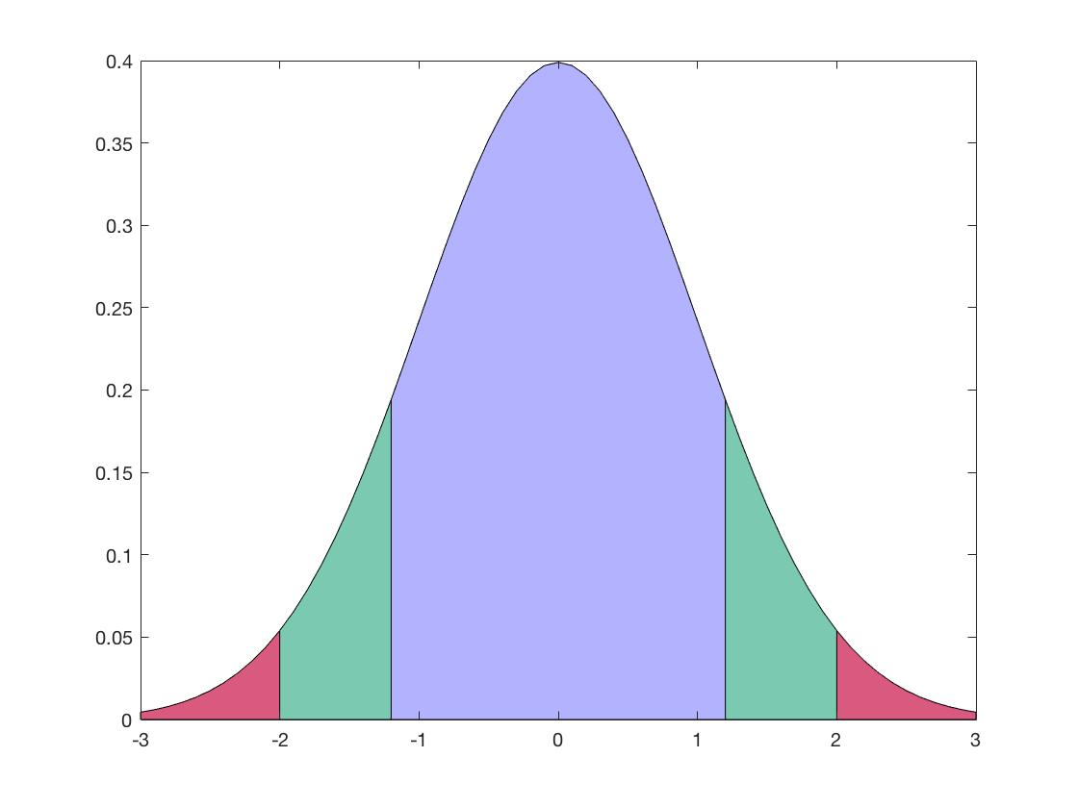
Spatio-temporal checks
Outliers in region A are investigated
Outliers in region B for “n” nearest neighbor stations and the station itself in a “d” day window period used to
validate outliers in region A.
A
B
Notes:
KH: Very helpful!

Slide 15
QC Statistics for India Data
TEMPERATURE
20 stations lack neighbours for spatio-temporal QC
Before QC: 59% of TMAX and 63% of TMIN values were missing
After QC: 60% of TMAX and 64% of TMIN values were missing
The hottest day on record is 51ºC at Phalodi, Rajasthan on 19 May 2016
The coldest day on record is -33.9ºC in Dras on 22 March 1911
No days exceeded the historical records.

Slide 16
QC Statistics for India Data
TEMPERATURE
There were 8 instances of TMIN values exceeding TMAX values at Station IN001050200 (Kakinada). For example:
  1987, 11, 11, 23.4 (TMAX)
  1987, 11, 11, 24.3 (TMIN)
There were multiple instances of repeated sequences of identical values. The longest repeated sequence was for station IN012070800 (Bombay SantaCruz)
  From May 6, 1978 to May 20, 1978 – every TMAX value was 33ºC

Slide 17
QC Statistics for India Data
PRECIPITATION
Maximum recorded rainfall – Cherrapunjee (49.05 in, 15th June 1995)
Number of NA values – same before and after QC (~42%)
Simple range checks
  Lower limit : 0 (no negative values)
  Upper limit: Highest recorded for a given geographic region (state/country)
No values found to be outside of range
Notes:
KH: Need more information here about the range checks. Did any stations exceed this range? Were there any repeated values?

Slide 18
Future climate projections for India
79 weather stations
64 have sufficient long-term data to be used for downscaling
Maximum and minimum temperature, 24 hour cumulative precipitation

Slide 19
In the future, we will be adding:
QA index - quantify quality assurance by categorizing the data as good or erroneous
Missing Data Flags – to determine usability of data
Continuous Real Time QC -- may be able to provide human feedback and to detect and fix source of errors.
Topographical Information

Slide 20
Questions?

